Slide 1

AN INTELLIGENT AI CHATBOT FOR LEGAL CASE PREDICTION USING BERT
PANIMALAR ENGINEERING COLLEGE
DEPARTMENT OF COMPUTER SCIENCE AND ENGINEERING
Bangalore Trunk Road, Poonamallee, Chennai – 600 123
GUIDE : DR KAVITHA SUBRAMANI
TEAM MEMERS : AKSHIDHA U [211420104014]
DEEPTHI L S [211420104058]
MONISHA D [211420104167]
DOMAIN : DEEP LEARNING
BATCH : A7
SDG GOAL : GOAL 16 -PEACE, JUSTICE AND STRONG INSTITUTIONS

Slide 2
ABSTRACT
Law and society are the most inseparable attainments of mankind. With the advent of human civilization began the formulation of the judicial system. A legal case prediction chatbot that uses cutting-edge BERT-based natural language processing models promises to simplify legal research and improve decision-making processes. The chatbot supports legal practitioners in forecasting case outcomes, locating important precedents, and providing insights into potential legal strategies through analyzing and comprehending the intricate details of legal texts.

Slide 3
EXISTING SYSTEM
In the era of generative AI, where people seek the help of chatbots to complete their tasks, we cannot find people relying on these bots for legal assistance. This is because:
The existing chatbots are either general purposed and not legal specific thus does not understand the legal texts or context.
People don’t find the user interface easy to operate which jeopardises the whole user interaction process.
Hence there is a need to build a bot which can interpret the legal context and provide suggestions through an user friendly interface.

Slide 4
LITERATURE REVIEW
Title | Authors | Methodology | Advantages | Limitations
Improving Access to Justice with Legal Chatbots [MDPI-2020] | Marc Queudot, Eric Charton, Marie-Jean Meurs | Uses several NLP models like bag-of-words, word embeddings and Recurrent Neural Networks(RNN) | The only data needed are discussions: no special annotation is required, so many corpora are usable. | The model tends to favor low-risk responses, which often amount to very short and uninteresting answers.
Case-level Prediction of Motion Outcomes in Civil Litigation [ACM -2021] | Devin J. McConnell, James Zhu, Sachin Pandya, Derek Aguiar | Ensemble Learning - Adaboost, Tree based models | All methods, excluding SVM, predicted motion to strike outcomes in vehicular cases with a significantly higher accuracy than tort cases | A limitation of the data in the analysis performed is that courts may occasionally grant a motion to strike in part.

Slide 5
LITERATURE REVIEW
Title | Authors | Methodology | Advantages | Limitations
Task-Oriented User Evaluation on Critiquing-Based Recommendation Chatbots [2022] | Wanling Cai , Yucheng Jin , and Li Chen | Critiquing mechanisms for DCRS | The findings suggest effective critiquing techniques to enhance the interaction between users and the recommendation chatbot when the system makes recommendations for different purposes. | Personalized recommendations to users are too aligned with their current preferences, which may lead to increasingly narrower exploration space over time.
Learning Fine-Grained Fact-Article Correspondence in Legal Cases [IEEE -2021] | J. Ge, Y. Huang, X. Shen, C. Li and W. Hu | Multi-level matching network | The fine-grained fact-article correspondences can improve the recommendation accuracy by a large margin. | The judgment document is only semi-structured, it is difficult to obtain key elements such as facts and cited articles automatically.

Slide 6
LITERATURE REVIEW
Title | Authors | Methodology | Advantages | Limitations
Study of Deep Learning-Based Legal Judgment Prediction in Internet of Things Era[2022] | Min Zheng, Bo Liu, Le Sun | Implemented a knowledge distillation-based legal decision prediction model, called KD-BERT | The KD-BERT model’s inference speed is also much faster than the other BERT models. | It has more than 115M encoder parameters, which seriously hinders the application of decision prediction algorithms.
On the Effectiveness of Pre-Trained Language Models for Legal Natural Language Processing: An Empirical Study | Dezhao Song, Sally Gao, Baosheng He, Frank Schilder | Gives an overview of all the PLM pre-trained Learning models PLM used in legal assistance. | Provides a comprehensive analysis on the pros and cons of the PLMs. | One potential future direction lies in being more selective about the texts we send to PLMs, i.e., Text Selection.

Slide 7
LITERATURE REVIEW
Title | Authors | Methodology | Advantages | Limitations
Using machine learning to predict decisions of the European Court of Human Rights, Artificial Intelligence and Law [Springer - 2020] | Masha Medvedeva, Michel Vols, Martijn Wieling. | Support Vector Machines | The results showed that using relatively simple and automatically obtainable information, their models are able to predict decisions correctly in about 75% of the cases. | There is a substantial drop in performance on the basis of the 10-year gap, likely caused by a large reduction in training data.
Adapting Legal Systems to the Development of Artificial Intelligence: Solving the Global Problem of AI in Judicial Processes [2023] | Gulyamov Said, Khudoberganov Azamat , Sharopov Ravshan, Abduvaliev Bokhadir | Focuses on international legal frameworks and practices on AI integration in courtrooms | Development of ethical guidelines, increased transparency of AI algorithms, implementation of sound data management practices. | Concerns about fairness and bias in AI-based predictive sentencing algorithms, as well as challenges in ensuring accuracy.

Slide 8
LITERATURE REVIEW
Title | Authors | Methodology | Advantages | Limitations
CREA: An Introduction to Conflict Resolution with Equitative Algorithms [SSRN 2021] | Marco Giacalone , Sajedeh Salehi | Explored fair division theory and algorithmic-based dispute resolution procedures. | Conducted a detailed analysis of legal investigations to identify the potential application of game-theory algorithms in civil disputes. | Highlights challenges in harmonizing algorithmic dispute resolution approaches in a diverse legal landscape.
Legal Norm Retrieval with Variations of the BERT Model Combined with TF-IDF Vectorization [ACM 2021] | Sabine Wehnert, Viju Sudhi, Shipra Dureja, Libin Kutty, Saijal Shahania, Ernesto W. De Luca | Focusing on combining Sentence-BERT and LEGAL-BERT with TF-IDF vectors | Multiple strategies, like data decomposition, augmentation, two-stage TF-IDF with Sentence-BERT, thresholding, and ensemble methods, improved recall | BERT-based methods may lack explainability compared to TF-IDF, potentially compromising precision; combining Sentence-BERT with TF-IDF and data enrichment adds complexity.

Slide 9
PROBLEM STATEMENT
One of the major limitation of the existing models is that the user doesn’t have the liberty to select their preferred legal case domain instead the models are either too narrow built for only one specific domain such as Human Rights or the models are too generic such that the prediction is not personalised for the user or their preferred case type. Hence there is a need to develop an application that would seamlessly allow the user to choose between the domains prior to interacting with the chatbot and this also increases the performance of the model.

Slide 10
OBJECTIVE
To develop an effective legal case prediction application using BERT , which includes an user friendly and interactive interface in which the user is bound to answer to the questions within the scope of one specific domain that they have chosen, hence increasing the trust and user satisfaction.

Slide 11
IMPLEMENTATION ENVIRONMENT
Hardware Requirements
Processor:
Intel i3 or above
Hard disk:
Min 16 GB or more
RAM:
Min 5 GB or more
GPU :
Compatible with CUDA
Software Requirements
Backend:
In Google Colabs
Python
Flask Api
Frontend:
In Visual Studio Code
React JS
HTML
CSS

Slide 12
PROPOSED METHODOLOGY
The proposed system is an AI chatbot which can provide assistance for legal cases.
Datasets will be collected from various resources and pre-processed into suitable format for training.
The deep learning models such as BERT (Base) and BERT(Large) are used to train the datasets.
A set of questions will be asked via an AI chatbot application to the user.
When all the answers are given for prediction process, it can easily determine the legal case type.
Thus, this project helps in effective prediction for lawyers in which type of legal case using chatbot application and deep learning technologies in an efficient manner.

Slide 13
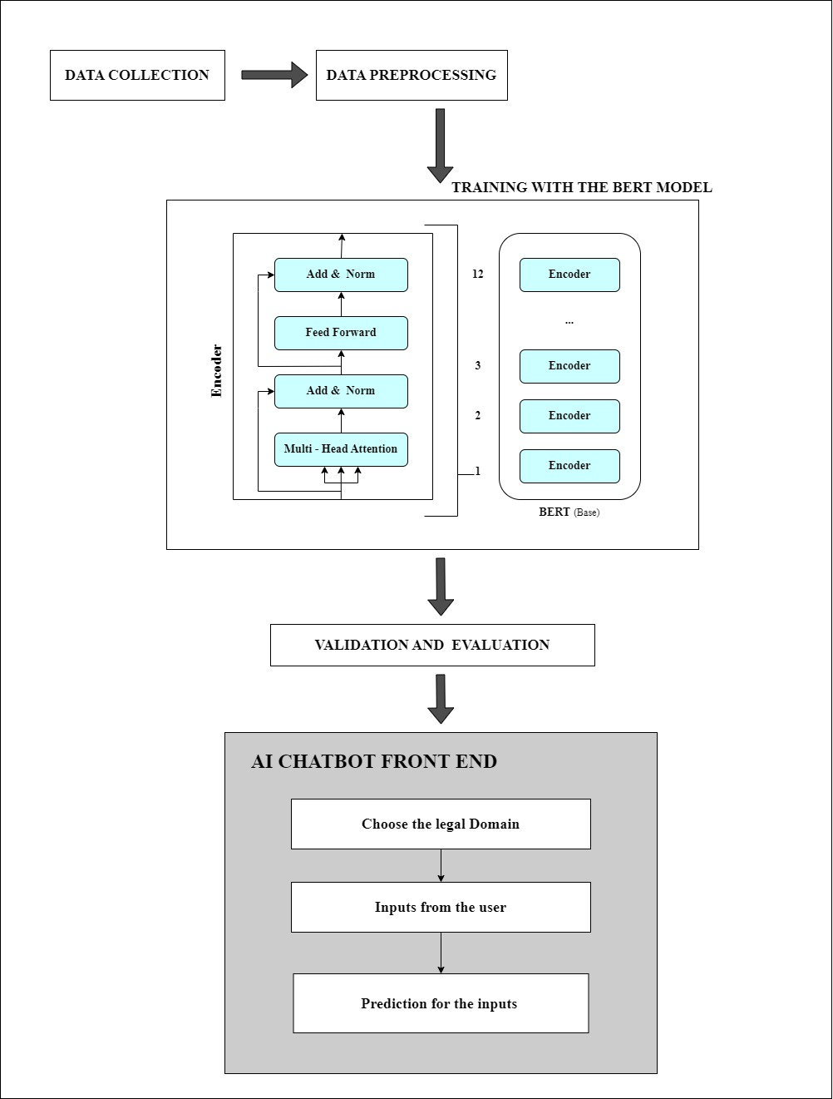
SYSTEM ARCHITECTURE

Slide 14
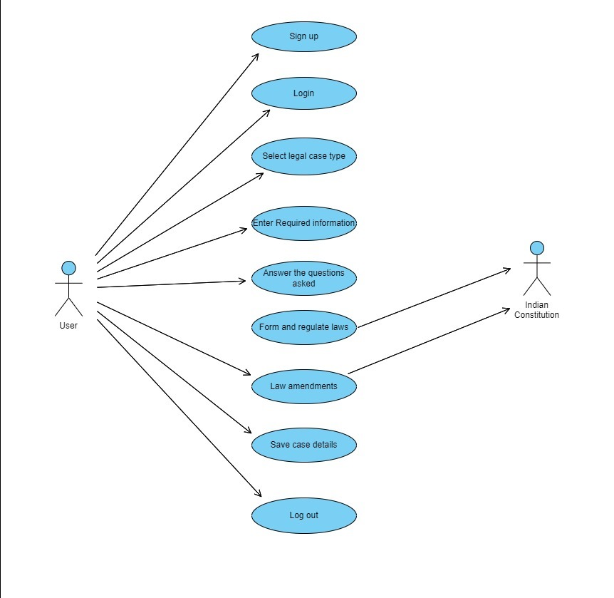
UML DIAGRAMS – Use Case Diagram

Slide 15
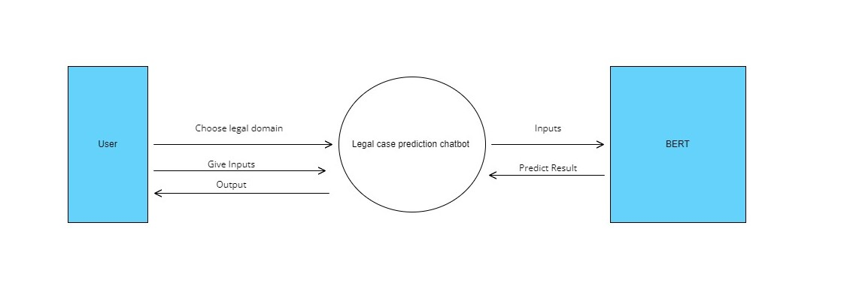
UML DIAGRAMS – DFD Level 0 Diagram

Slide 16
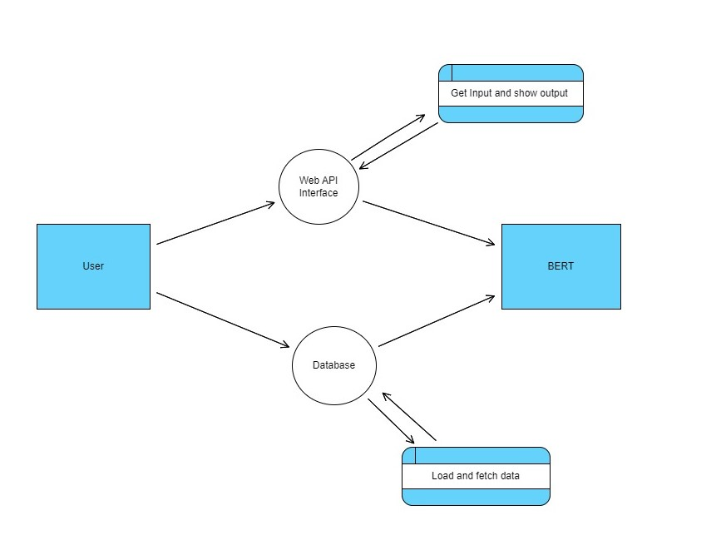
UML DIAGRAMS – DFD Level 1 Diagram

Slide 17
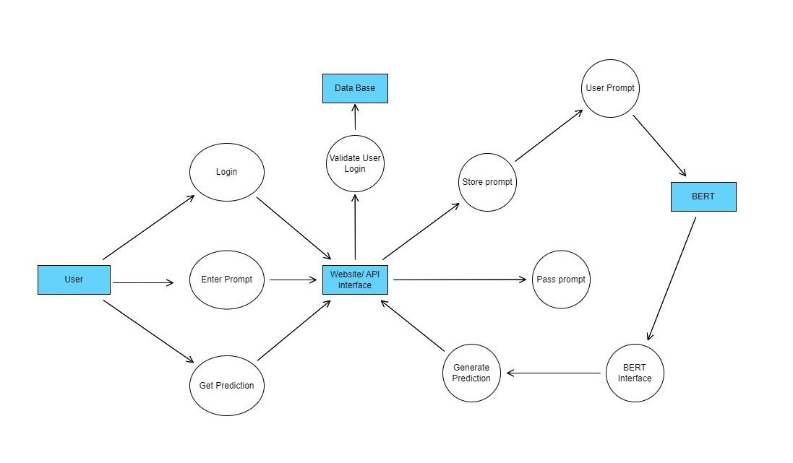
UML DIAGRAMS – DFD Level 2 Diagram

Slide 18
MODULE DESIGN
List of Modules:
The modules involved in this project includes:
Data Collection
Data Preprocessing
Training the BERT model
Validation and Evaluation of the model
Deployment (User Interface)

Slide 19
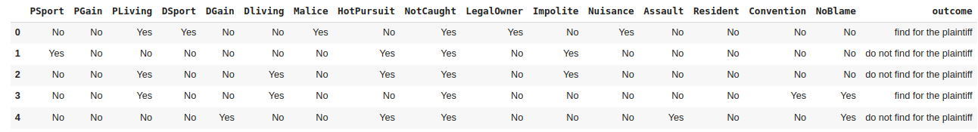
DATA COLLECTION
Dataset Description:
The dataset used in this project is collected from a third party and it contains the three types of legal case such as Wild Animals, Trade Secret, Fourth Amendment.
Sample of the Dataset

Slide 20
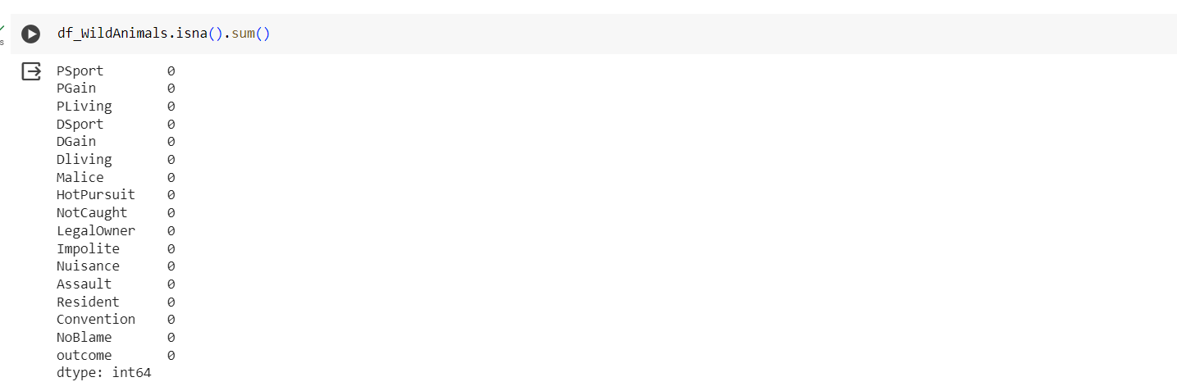
DATA PREPROCESSING
Handling the Missing Values
1. Handling the Missing Values

Slide 21
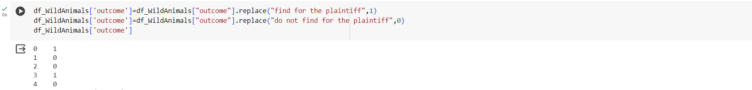
DATA PREPROCESSING
Handling the Missing Values
2. Label Encoding Target Variable

Slide 22
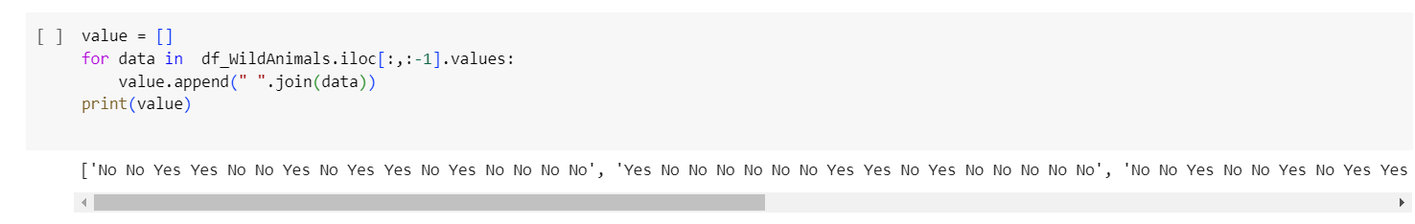
DATA PREPROCESSING
Handling the Missing Values
3. Feature Concatenation of Independent Variables

Slide 23

SYSTEM IMPLEMENTATION
BERT - Bidirectional Encoder Representations from Transformers
BERT, which stands for Bidirectional Encoder Representations from Transformers, is a natural language processing (NLP) model developed by Google, which is based in the transformers architecture.
BERT has significantly advanced the state-of-the-art in various NLP tasks, including question answering, sentiment analysis, and named entity recognition.
BERT is pre-trained on two different, but related, NLP tasks: Masked Language Modelling and Next Sentence Prediction.
The main objective of the BERT can be given as follows

Slide 24
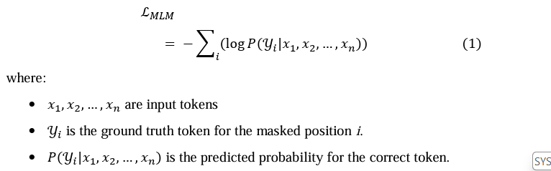
SYSTEM IMPLEMENTATION
Masked Language Model (MLM)

Slide 25
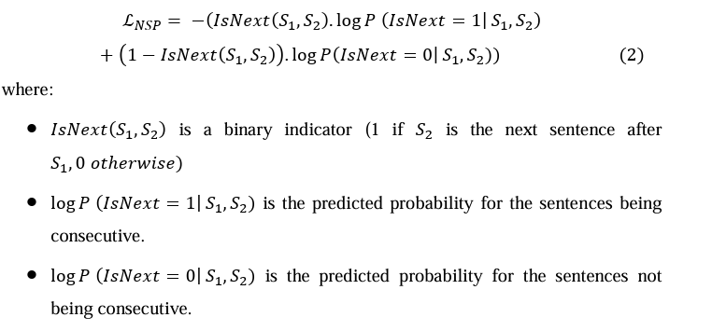
SYSTEM IMPLEMENTATION
Next Sentence Prediction (NSP)

Slide 26
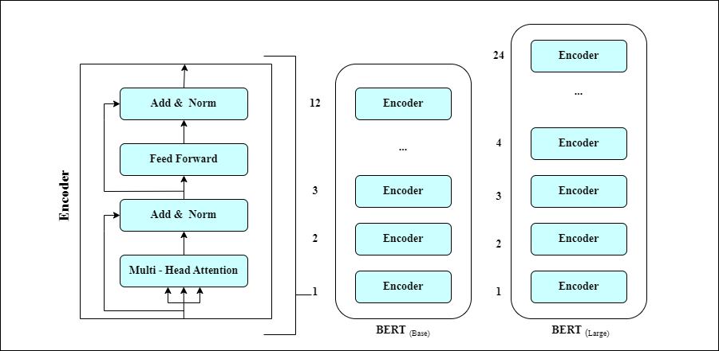
BERT Architecture
BERT - Bidirectional Encoder Representations from Transformers
BERT Architecture

Slide 27
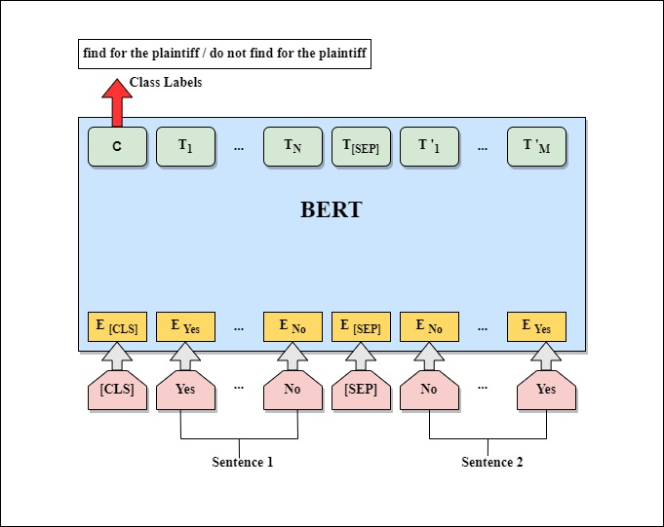
BERT - Bidirectional Encoder Representations from Transformers
Single Sentence Classification

Slide 28
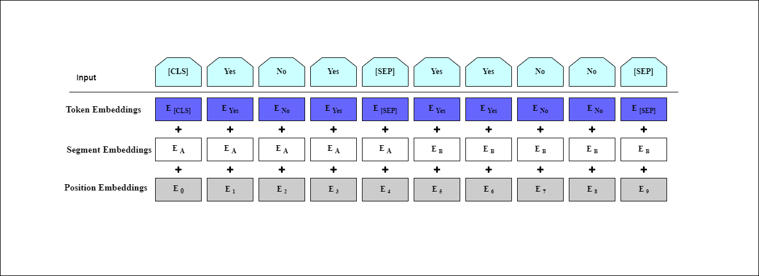
BERT - Bidirectional Encoder Representations from Transformers
Training Inputs

Slide 29
RESULTS
ACCURACY
ACCURACY
PRECISION
Legal Case Type | BERT Base | BERT Large
Wild Animals | 80.0 | 60.0
Trade Secret | 90.62 | 84.37
Fourth Amendment | 88.88 | 66.66
Legal Case Type | BERT Base | BERT Large
Wild Animals | 0.75 | 0.60
Trade Secret | 0.95 | 0.95
Fourth Amendment | 0.86 | 0.67

Slide 30
RESULTS
ACCURACY
RECALL
F1 - SCORE
Legal Case Type | BERT Base | BERT Large
Wild Animals | 1.00 | 1.00
Trade Secret | 0.95 | 1.00
Fourth Amendment | 1.00 | 1.00
Legal Case Type | BERT Base | BERT Large
Wild Animals | 0.86 | 0.75
Trade Secret | 0.95 | 0.97
Fourth Amendment | 0.92 | 0.80

Slide 31
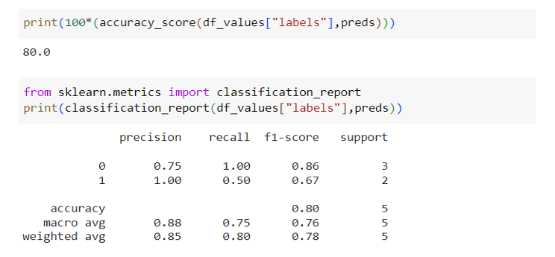
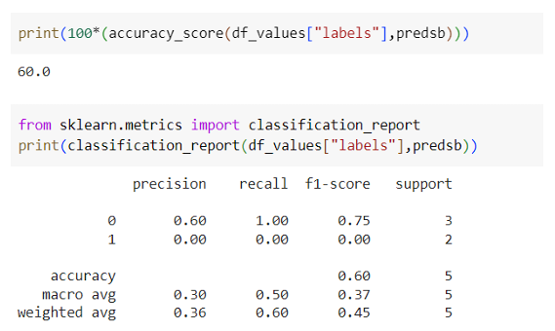
RESULTS
BERT (Base)
Wild Animals
BERT (Base)
BERT (Large)

Slide 32
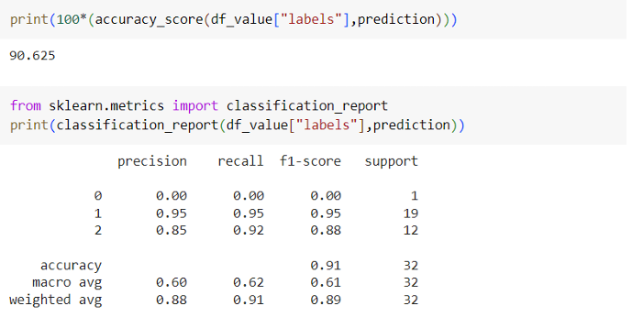
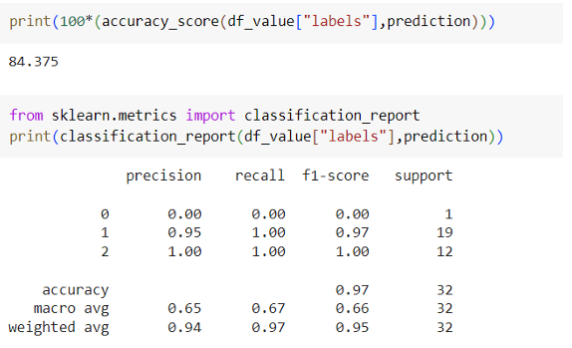
RESULTS
BERT (Base)
Trade Secrets
BERT (Base)
BERT (Large)

Slide 33
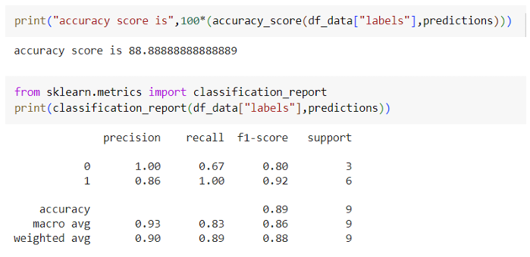
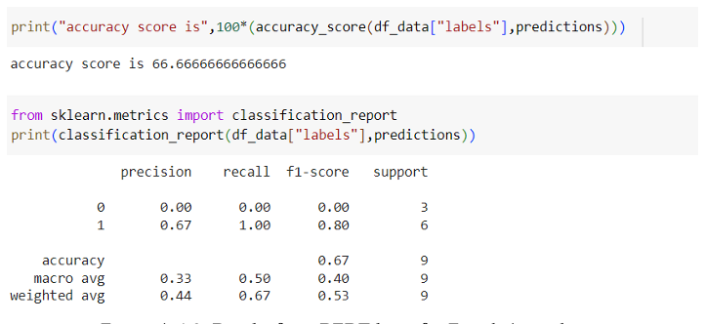
RESULTS
ACCURACY
Fourth Amendments
BERT (Base)
BERT (Large)

Slide 34
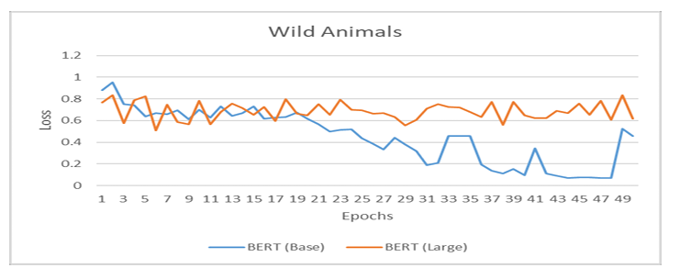
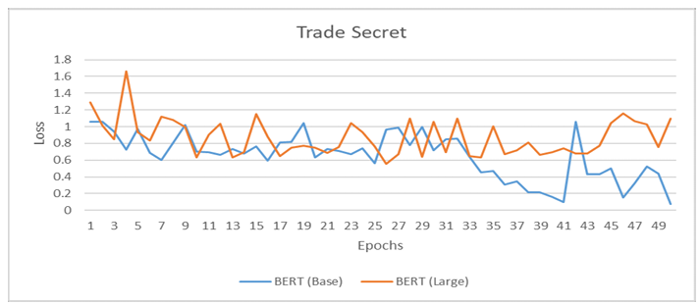
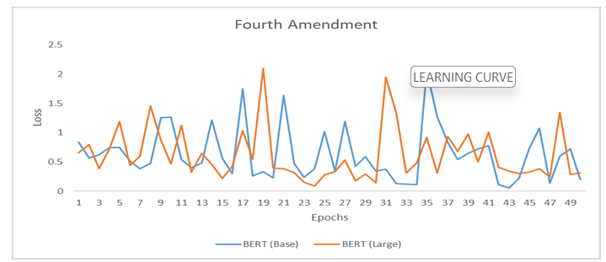
LEARNING CURVE
ACCURACY

Slide 35

SCREENSHOTS
Login Page

Slide 36
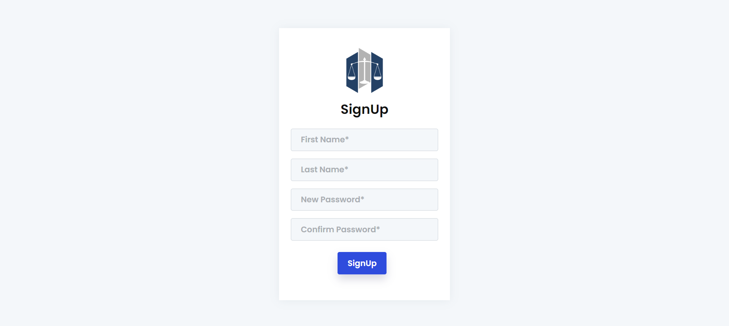
SCREENSHOTS
SignUp Page
SignUp Page

Slide 37
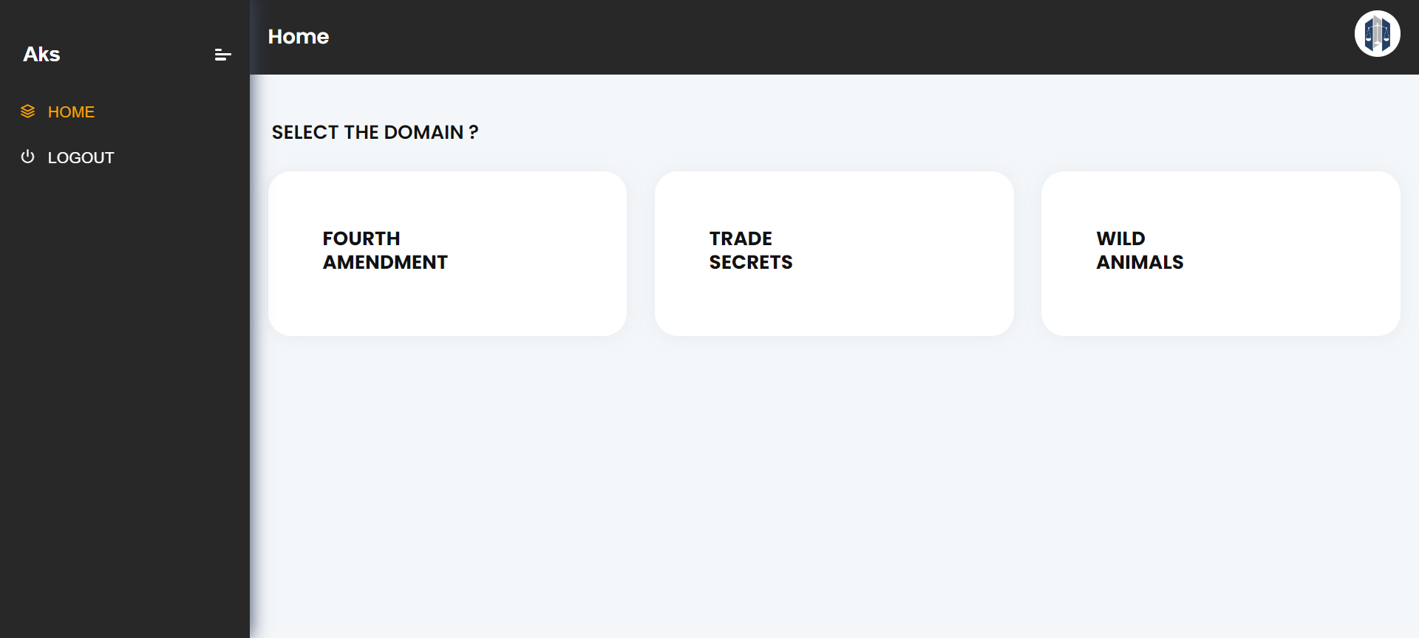
SCREENSHOTS
Legal Case Domain Page

Slide 38
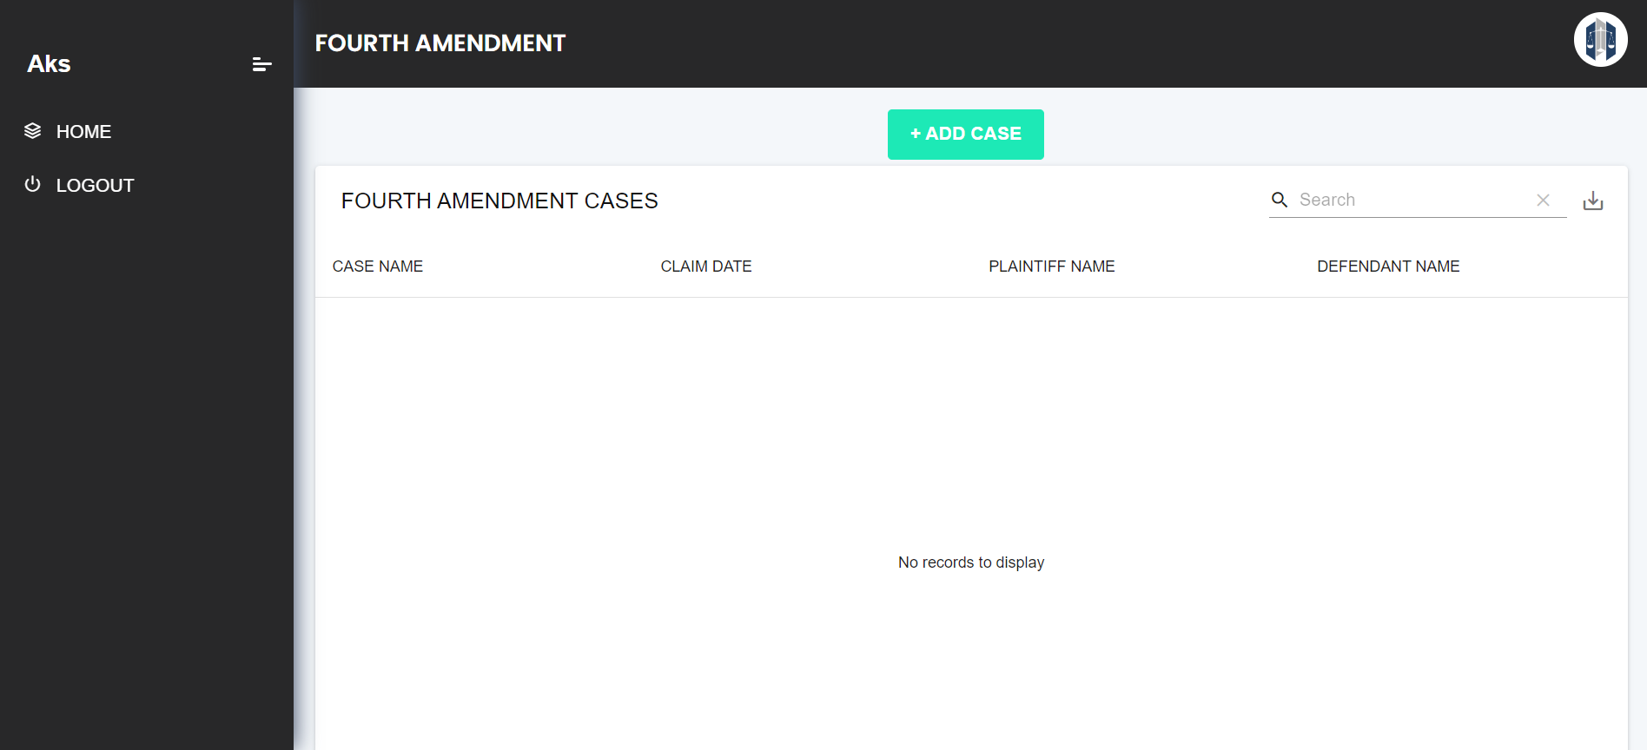
SCREENSHOTS
Legal Case Home Page
Legal Case Home Page

Slide 39
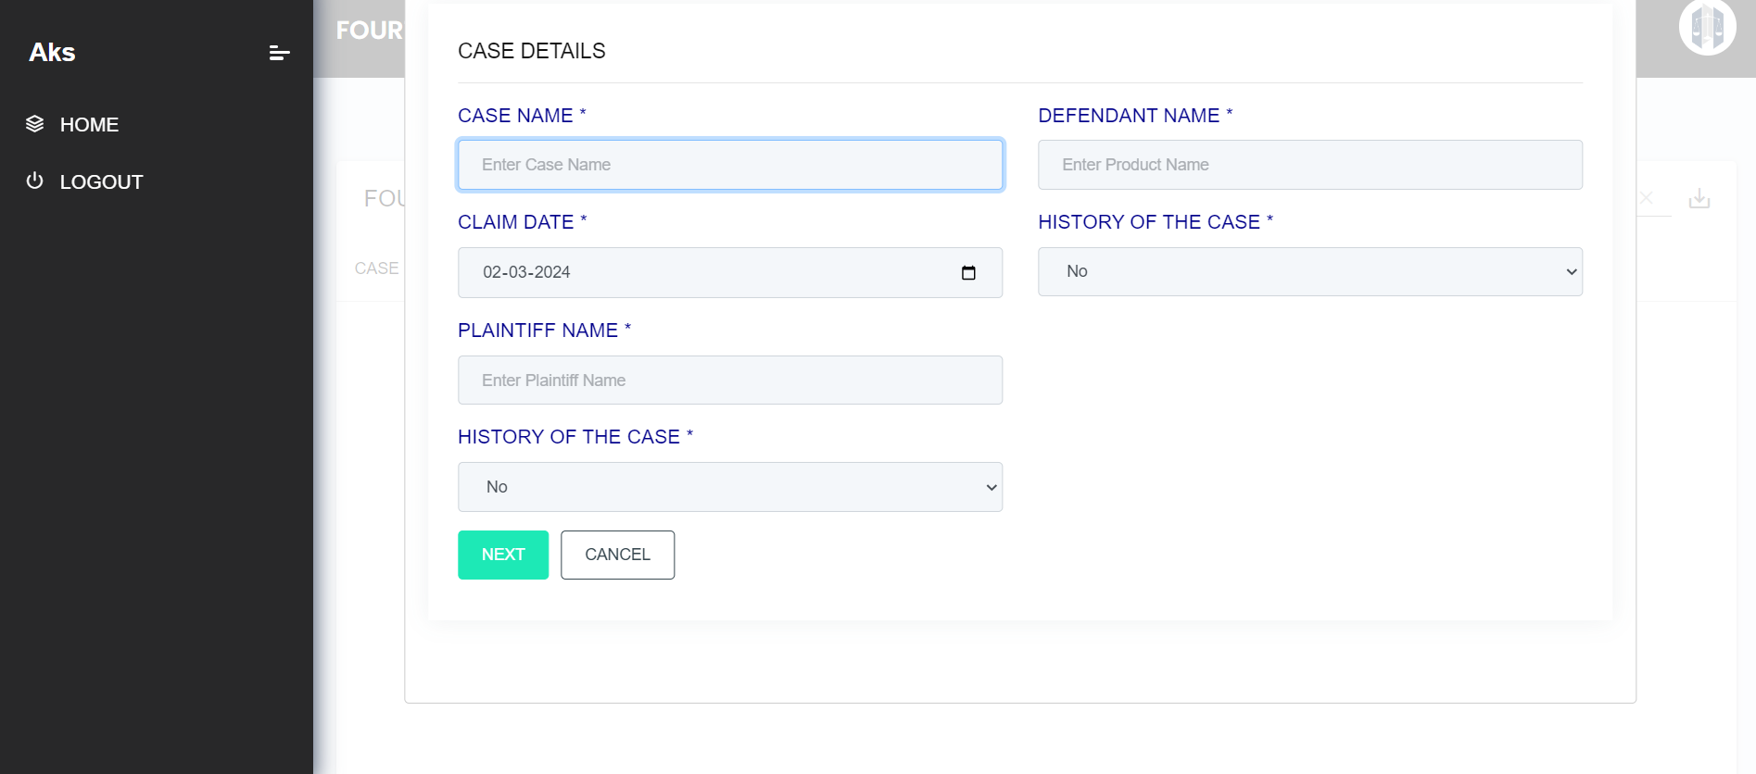
SCREENSHOTS
Case Details Input Session

Slide 40
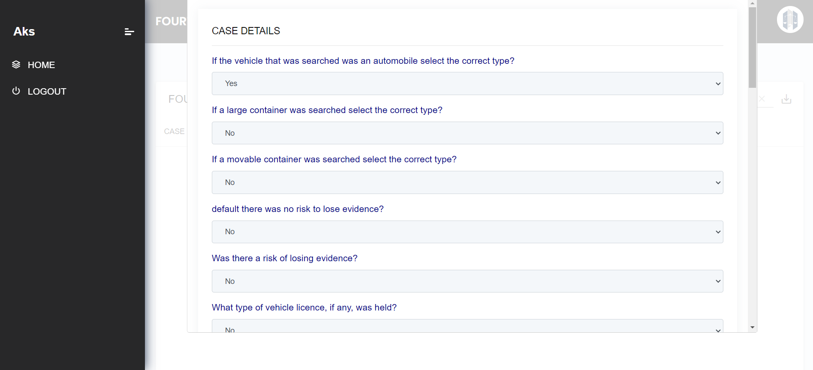
SCREENSHOTS
Question and Answers Page

Slide 41
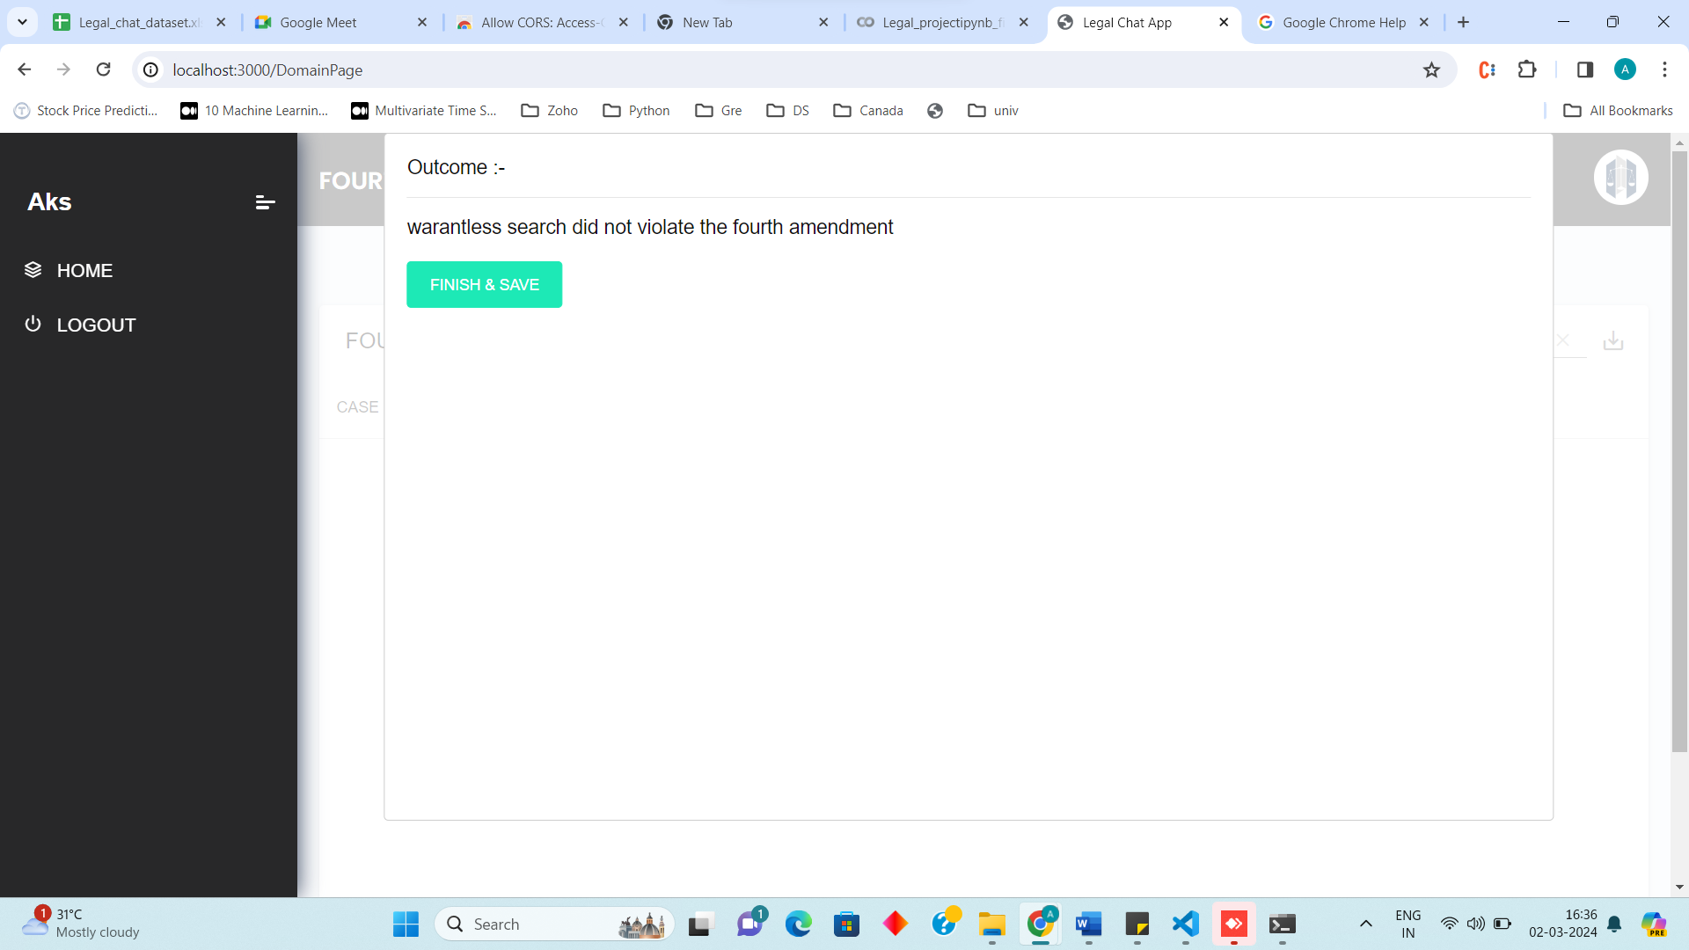
SCREENSHOTS
Outcome Page

Slide 42
REFERENCES
Devin J. McConnell, James Zhu, Sachin Pandya, Derek Aguiar (2021). Case- level Prediction of Motion Outcomes in Civil Litigation. ACM, Pages 99–108.
Dezhao Song, Sally Gao, Baosheng He, Frank Schilder (2022). On the Effectiveness of Pre-Trained Language Models for Legal Natural Language Processing: An Empirical Study. IEEE,vol.10,pp 75835-75858.
Flora Amato, Mattia Fonisto, Marco Giacalone, d Carlo Sansone (2023). An Intelligent Conversational Agent for the Legal Domain. MDPI.
J. Ge, Y. Huang, X. Shen, C. Li and W. Hu (2021). Learning Fine-Grained Fact- Article Correspondence in Legal Cases. IEEE vol.29, pp.3694-3706.
Gulyamov Said, Khudoberganov Azamat , Sharopov Ravshan, Abduvaliev Bokhadir (2023). Adapting Legal Systems to the Development of Artificial Intelligence: Solving the Global Problem of AI in Judicial Processes. IRSHAD Journals,vol.1.
Hossein Hassani, Emmanuel Sirmal Silva (2023). The Role of ChatGPT in Data Science: How AI-Assisted Conversational Interfaces Are Revolutionizing the Field. MDPI.
JoaoV.F.Franca, Jose M.C.Boaro, Pedro T.C dos Santos et.al (2020). Legal Judgment Prediction in the Context of Energy Market using Gradient Boosting. IEEE.
Joel Niklaus, Ilias Chalkidis, Matthias Stürmer (2021). Swiss-Judgment- Prediction: A Multilingual Legal Judgment Prediction Benchmark. arXiv.
Joel Niklaus, Ilias Chalkidis, Matthias Stürmer (2021). Swiss-Judgment- Prediction: A Multilingual Legal Judgment Prediction Benchmark. arXiv.

Slide 43
REFERENCES
Masha Medvedeva, Michel Vols, Martijn Wieling (2020). Using machine learning to predict decisions of the European Court of Human Rights. Springer.
Marc Queudot, Eric Charton, Marie-Jean Meurs (2020). Improving Access to Justice with Legal Chatbots. MDPI pp.356-375.
Min Zheng, Bo Liu, Le Sun (2022). Study of Deep Learning-Based Legal Judgment Prediction in Internet of Things Era. Hindawi.
Nut Limsopatham, (2021). Effectively Leveraging BERT for Legal Document Classification. Year. ACL Anthology.
Sabine Wehnert, Viju Sudhi, Shipra Dureja, Libin Kutty, Saijal Shahania, Ernesto W. De Luca (2021). Legal Norm Retrieval with Variations of the BERT Model Combined with TF-IDF Vectorization. ACM pp.285-294.
Samuel Maireg Biresaw, Abhijit Umesh Saste (2022). The Impacts of Artificial Intelligence on Research in the Legal Profession. IJLS vol.5,pp.53-65.
Wanling Cai , Yucheng Jin , and Li Chen (2022). Task-Oriented User Evaluation on Critiquing-Based Recommendation Chatbots. IEEE,vol.52 pp.354-366.
Xuerui Shang (2022). A Computational Intelligence Model for Legal Prediction and Decision Support. Hindawi.
Vijit Malik, Rishabh Sanjay, Shubham Kumar Nigam, Kripabandhu Ghosh, Shouvik Kumar Guha, Arnab Bhattacharya, Ashutosh Modi (2021), ILDC for CJPE: Indian Legal Documents Corpus for Court Judgment Prediction and Explanation, ACL Anthology

Slide 44
THANK YOU

